Slide 1

AURORA SPORT – NET ZERO SHIPPING
innovative Eletric boat

Slide 2
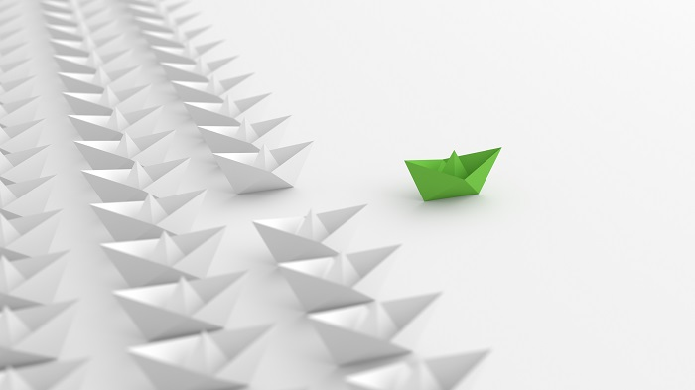
CLEAN DESIGN – ENVIRONMENTAL FRIENDLY OPERATION;
GREEN PASSPORT – USE OF RECYCLABLE MATERIALS;
ERGONOMIC DESIGN – LOW NOISE AND VIBRATION;
HULL WITH HIGH ENERGY EFFICIENCY.
SUSTAINEABLE LEISURE

Slide 3
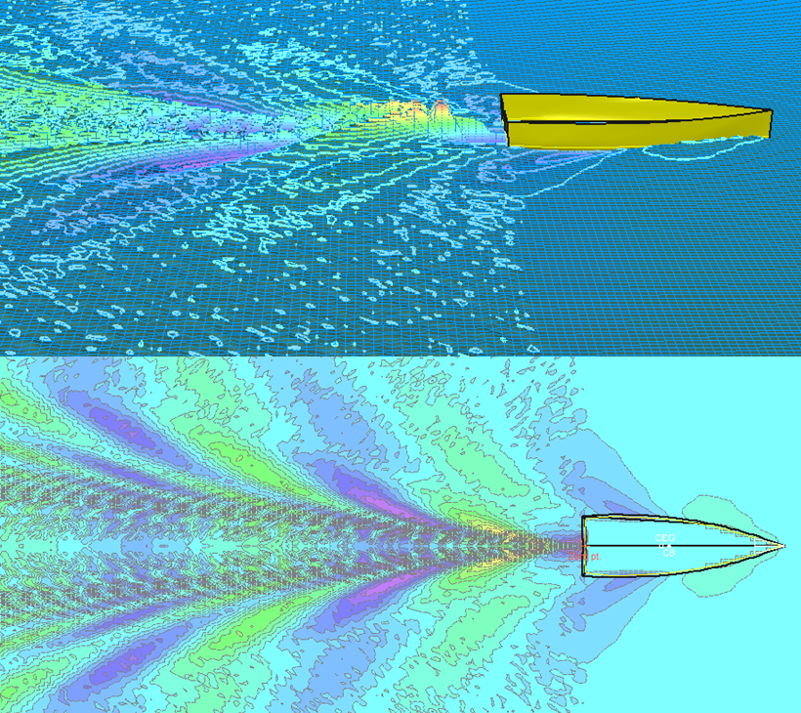
LAMARCA ENGENHARIA reaches an optimized hull design by using CFD Analysis (Computational Fluid Dynamics). The increase of the hydrodynamic efficiency leads to a reduction of the required power, and a lower acquisition and overall operational cost.
AURORA SPORT PROJECT

Slide 4
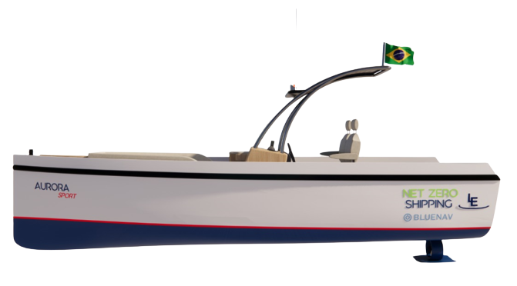
AURORA SPORT PROJECT

Slide 5
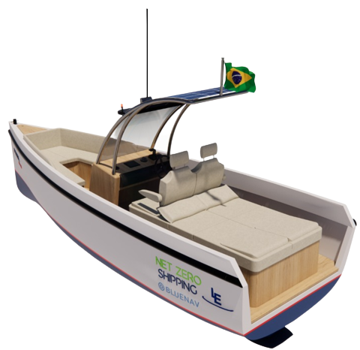
AURORA SPORT PROJECT

Slide 6
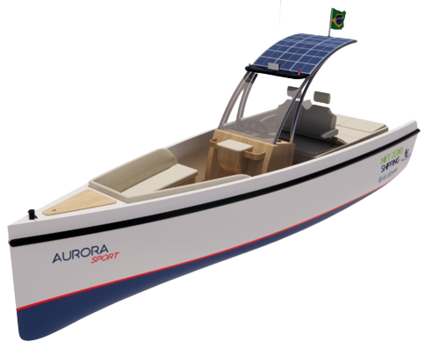
AURORA SPORT PROJECT

Slide 7
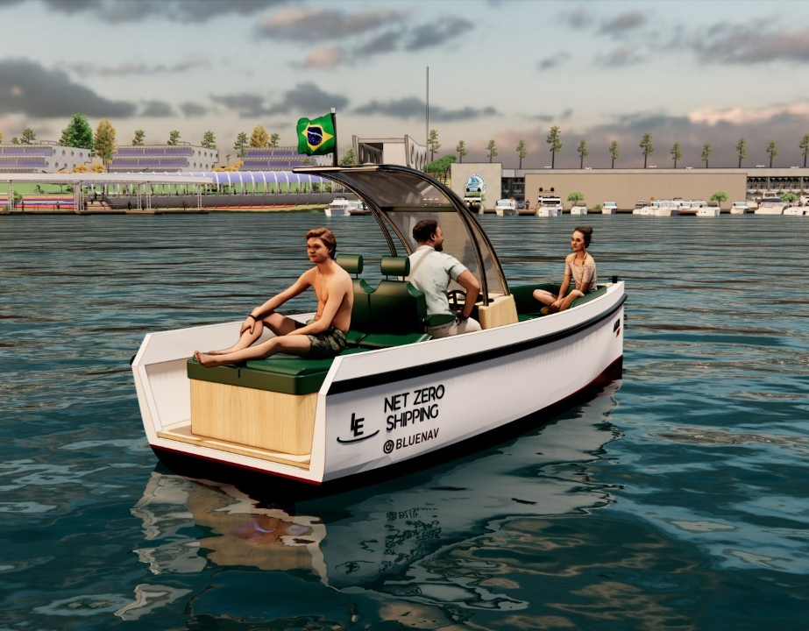
MAIN DIMENSIONS
LENGTH OVERALL | 5,80 m
MOULDED BEAM | 1,8 m
DEPTH | 1,00 m
DRAFT | 0,23 m
PEOPLE | 4
POWER | 15 kW
MAX. SPEED | 10 kN
AVERAGE SPEED | 7 kN
AUTONOMY | 4 hours
AURORA SPORT PROJECT

Slide 8
AURORA SPORT PROJECT

Slide 9
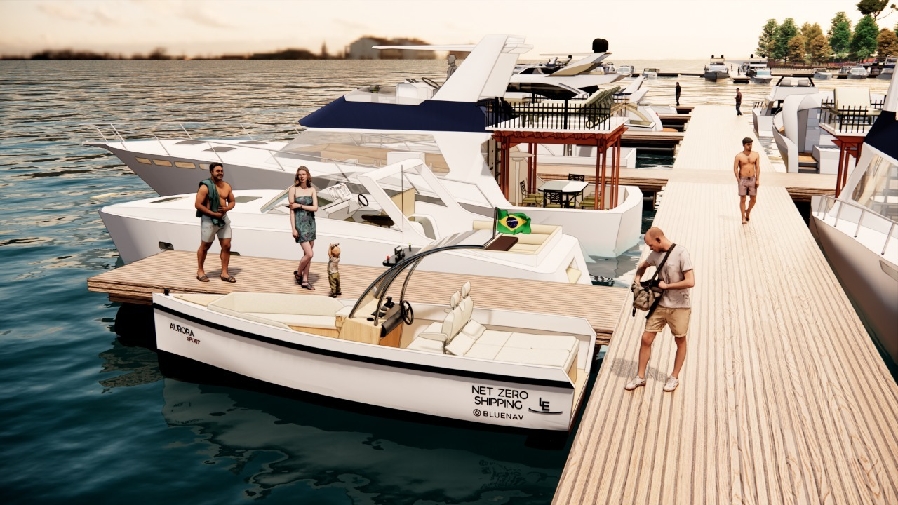
AURORA SPORT PROJECT

Slide 10
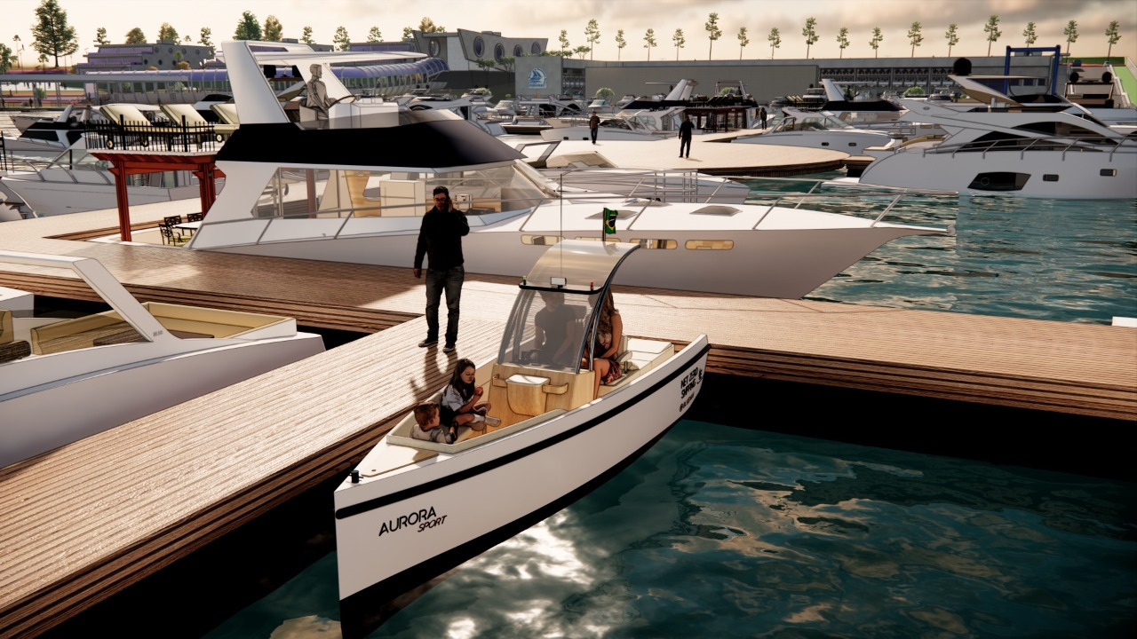
AURORA SPORT PROJECT

Slide 11
AURORA SPORT PROJECT

Slide 12
AURORA SPORT PROJECT

Slide 13
AURORA SPORT PROJECT

Slide 14
AURORA SPORT PROJECT

Slide 15
AURORA SPORT PROJECT

Slide 16
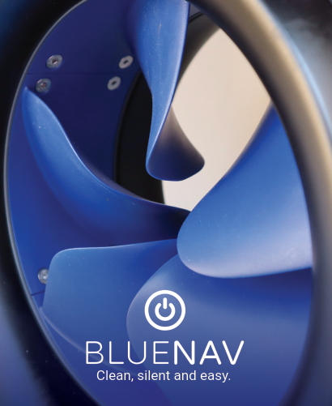
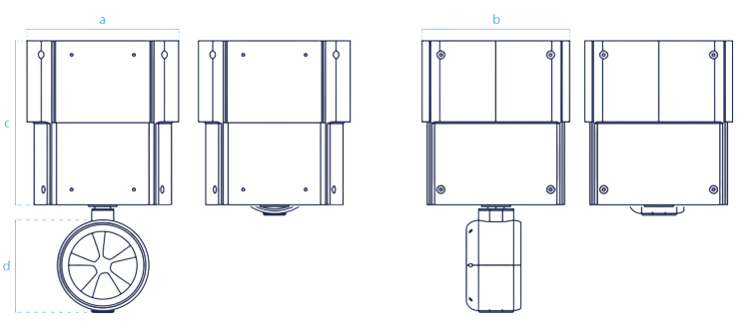

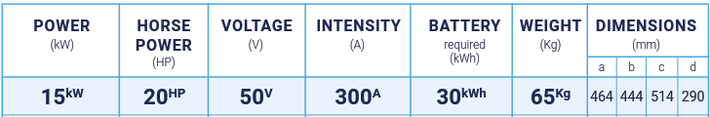
BlueNav is French’s manufacturer of electric propulsion for boats
zero noise, zero emissions, zero vibration
An innovative and ecological solution of electric motorization:
a
b
BlueSpin Inhull Retractable
c
d

Slide 17
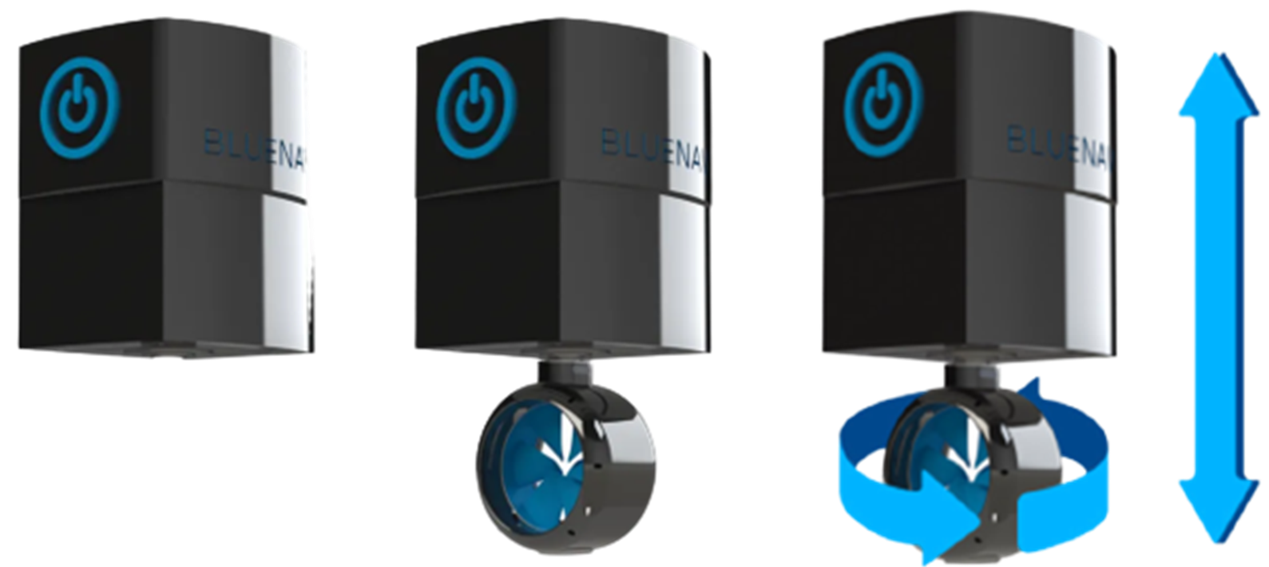
Electric propulsion for boats based on permanent magnet electric motor technology
BlueSpin Inhull Retractable

Slide 18
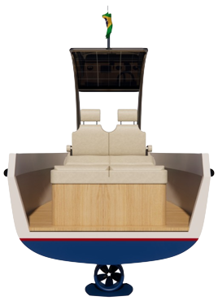
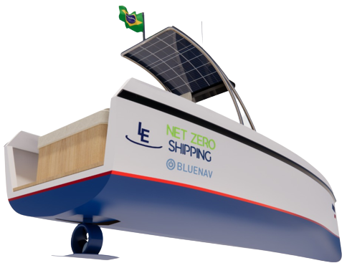
BlueSpin Inhull Retractable

Slide 19

LAMARCA ENGENHARIA is a startup that brings together professionals from the marine, offshore and industrial markets, developing innovative engineering and project management solutions in a virtual coworking environment, providing services in many regions of Brazil.
WHO ARE WE?

Slide 20
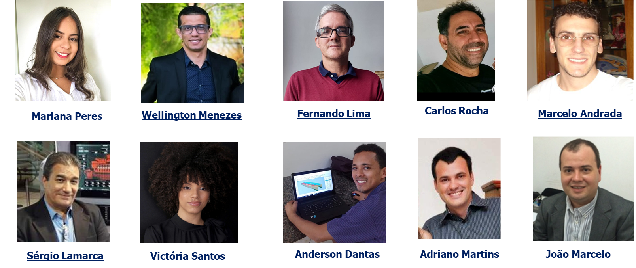
AURORA SPORT DESIGN & ENGINEERING TEAM

